Slide 1
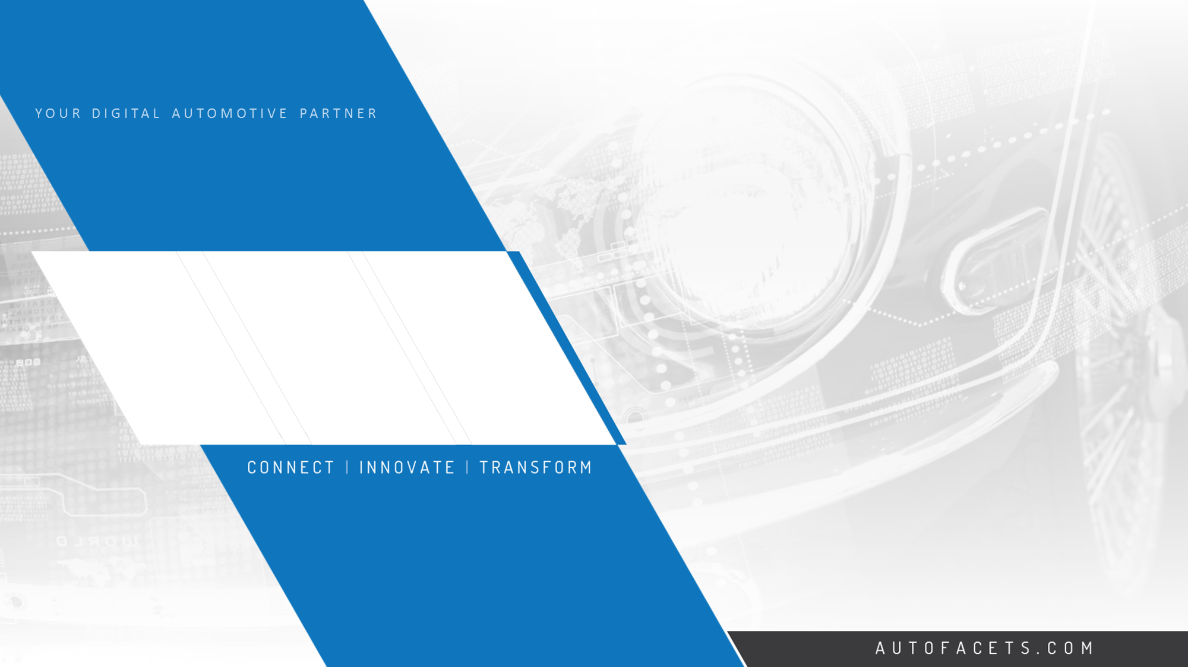




STC Overview
Way of Working

Slide 2
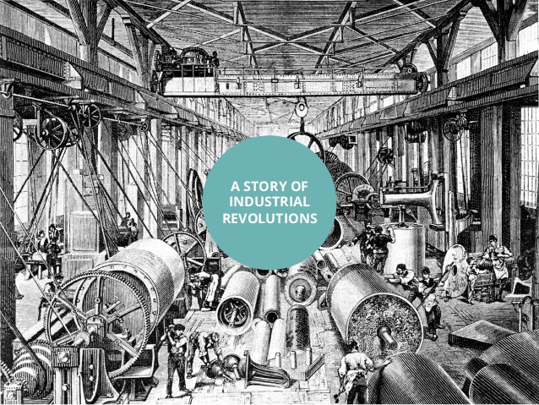

Slide 3
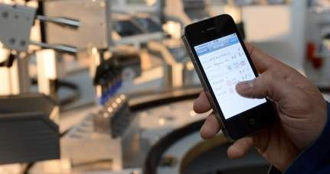
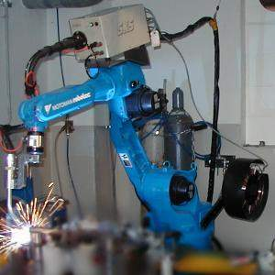
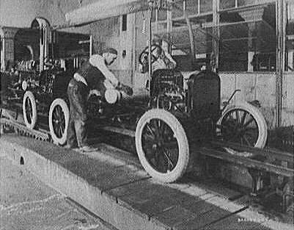
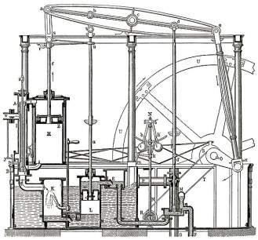
Industrial Evolution
4. Industrial revolution
Based on cyber-physical-
systems
3. Industrial revolution
Through the use of electronics
and IT further progression in
autonomous production
2. Industrial revolution
Introducing mass production
lines powered by electric
energy
Level of complexity
1. Industrial revolution
Introducing mechanical
production machines powered
by water and steam
Industry 1.0
Industry 2.0
Industry 3.0
Industry 4.0
End of the
18th century.
Beginning of the
20th century
Beginning of the
70th
Today

Slide 4


INDUSTRY 4.0
The term Industry 4.0 refers to the combination of several major Innovations in digital technology to transform the energy and manufacturing sectors
Cyber
Security
Mobile Technologies
Advanced Robotics
3D Printing
Cognitive Computing
Technologies
Cloud
Computing
Machine to Machine
RFID Technologies
Big Data/ Analytics
Internet of Things

Slide 5
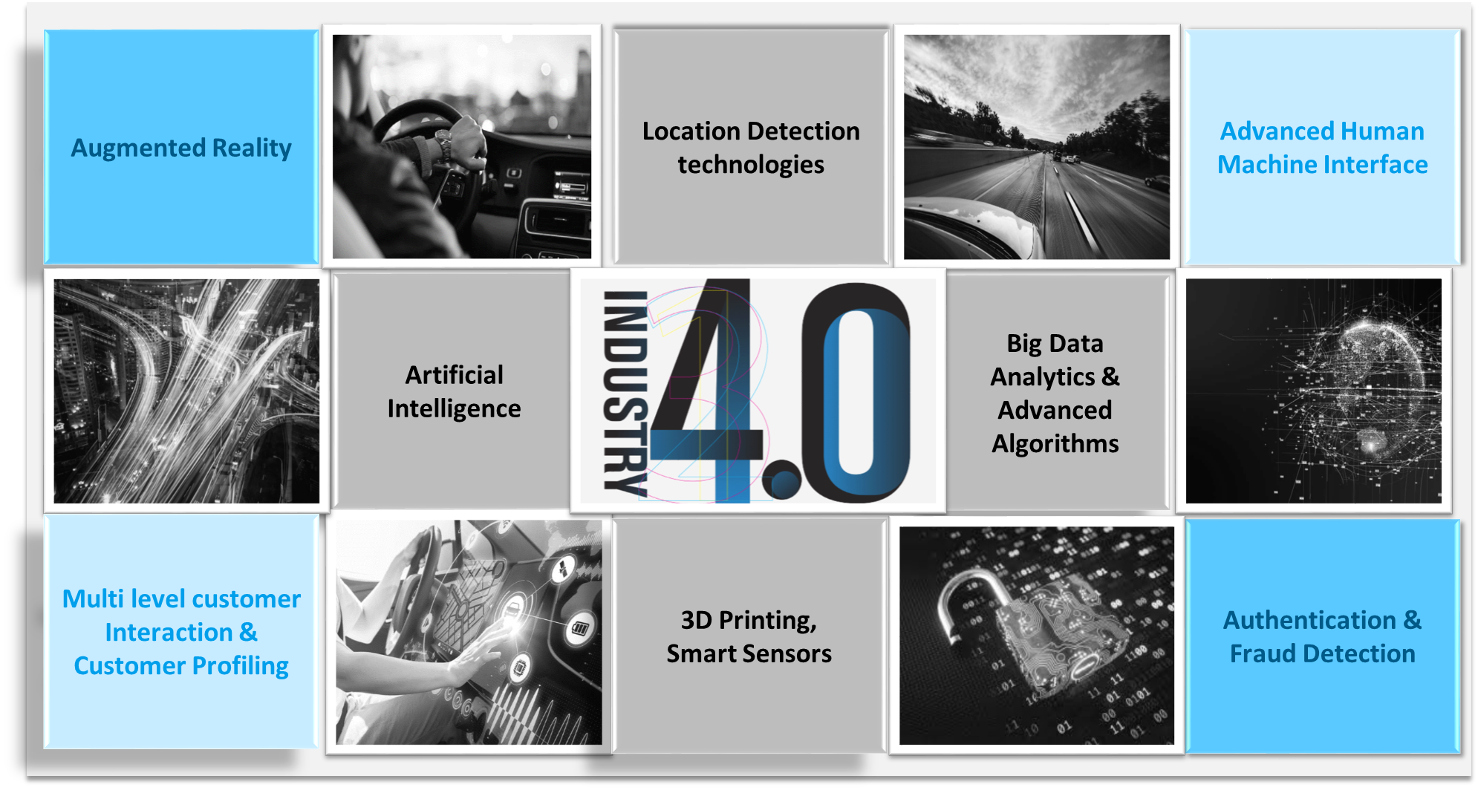
Applications

Slide 6
Value Drivers
10 to 40%
Reduction in maintenance cost
Predictive maintenance
Remote maintenance
Virtually guided self-service
Smart Energy Consumption
Intelligent lots
Real-time yield optimization
3 to 5%
Productivity increases
Customer cocreation/Open innovation
Concurrent Engineering
Rapid Experimentation
Routing Flexibility
Machine Flexibility
Predictive maintenance
Augmented reality
Services/ Aftersales
Resource/Processes
20 to 50%
Reduction in time to market
30% to 50%
Reduction of total machine downtime
Time to Market
Asset utilization
VALUE DRIVERS
Supply/
Demand matching
Human-robot collaboration
Remote monitoring & control
Digital Performance maintenance
Data-driven demand prediction
Data-driven design to value
Labor
45 to 55%
Increased productivity in technical professions through automation of knowledge work
85%+
Forecast accuracy increased
Quality
Inventories
Statistical Process control
Advanced Process Control
Digital Quality management
Real-time supply chain optimization
Batch size-1
10 to 20%
Cost of quality reduced by
20 to 50%
Cost of Inventory holding decreased

Slide 7

INDUSTRY 4.0- IMPACT ON AUTOMOTIVE INDUSTRY
Shifts to connected mobility
Car ownership shifts to co-sharing mobility
OEMs become service based business.
Tech companies are becoming smart vehicles manufactures
I4.0 will chart certain Mega Trends that are expected to be key enablers for the automotive industry‘s transition:
CLOUD COMPUTING
BIG DATA ANALYTICS
BROADBAND CONNECTIVITY
ECOMMERCE
IOT

Slide 8
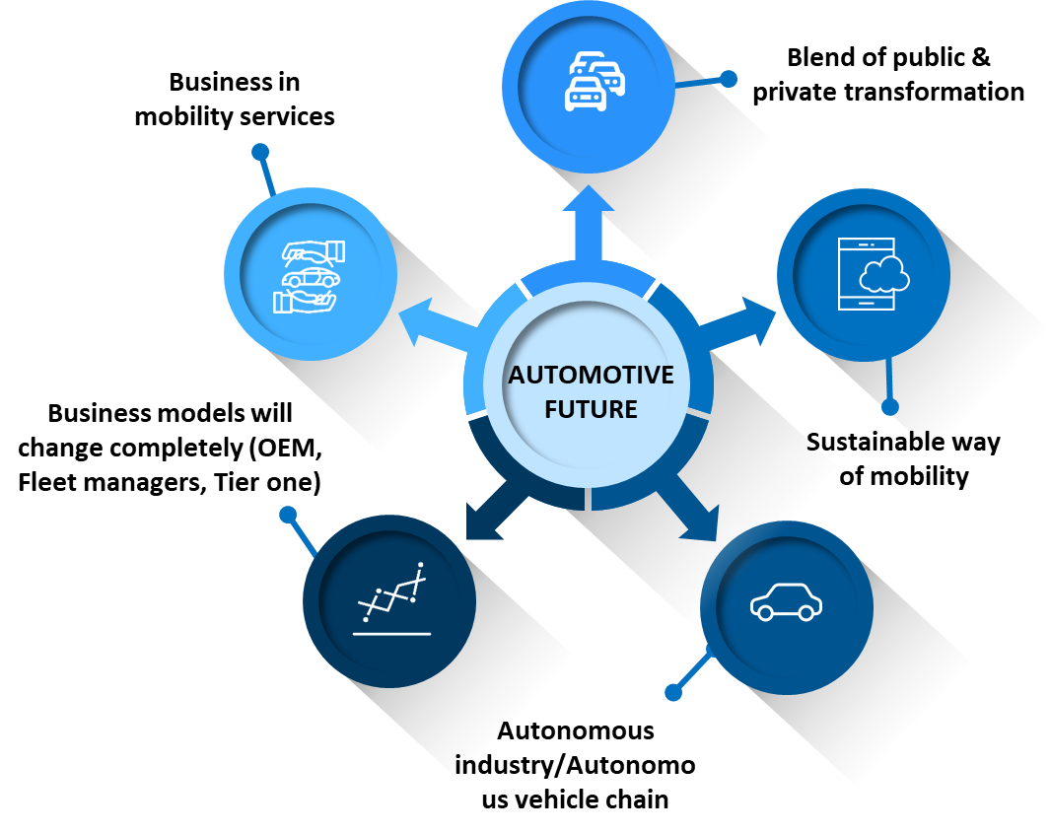

Transformation in Automotive Industry
Connected car, Autonomous driving are the Future of Automotive Industry

Slide 9
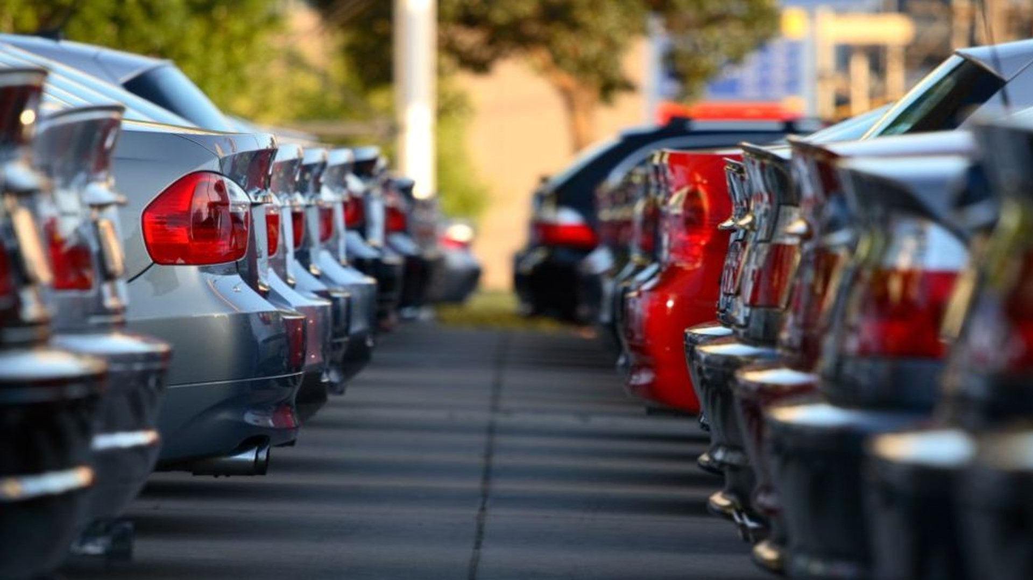
AUTOFACETS OVERVIEW

Slide 10


Automotive - Global Leader in Digital Automotive Solutions
WE DELIVER VALUE WITH
Domain Experience | Business Solutions | Technology expertise

Slide 11
Automotive - Global Leader in Digital Automotive Solutions
SERVICES
PRODUCTS
Digital Transformation
Automotive IT consulting
Product Lifecycle Management
Enterprise Mobility
Business Intelligence
Aftermarket Suite
Car Connect Platform
Parts Ecommerce
Auto-Lytics platform
Lease & Rental Suite
Mobility As a Service
SOLUTIONS
INNOVATIONS
Proactive Maintenance
Telematics
Parts Catalogue, PIM.
Digital Marketing
Integrated Mobility
Private Lease
360° Customer
Behavior Analytics
Business Intelligence
Automotive Blockchain
Artificial Intelligence
Dynamic Pricing Science
Automotive IoT
Machine Learning
Big Data
WE DELIVER VALUE WITH
Domain Experience | Business Solutions | Technology expertise
www.autofacets.com

Slide 12

AutoFacets – Segment wise Solutions
Manufacturing & Sales
CAR CONFIGURATOR
DYNAMIC PRICING
REMARKETING PLATFORM
OEM
Importer
Distributors
Dealers
Remarketing
Insurance
Parts – Wholesaler, Supplier, Dealers
Services
Fleet Services
Maintenance Services
Aftermarket
FLEET MANAGEMENT SOLUTION
LEAD TO ORDER
DRIVER PORTAL
DEALER QUOTER
CAR SHARING PLATFORM
CUSTOMER APP
ONLINE PLANNER
DIGITAL WORK ORDER
ALPR
SMART KIOSK
KEY DROP OFF / PICK UP
SMR PLATFORM
Mobility Services
Tyres & Wheels
Rental
Damage Repairs
Lease
Glass Repairs

Slide 13
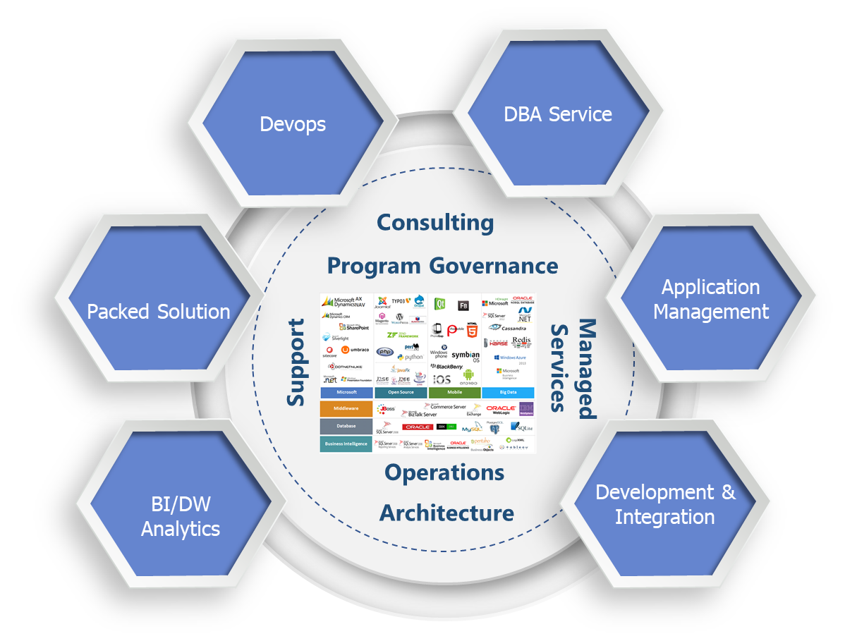
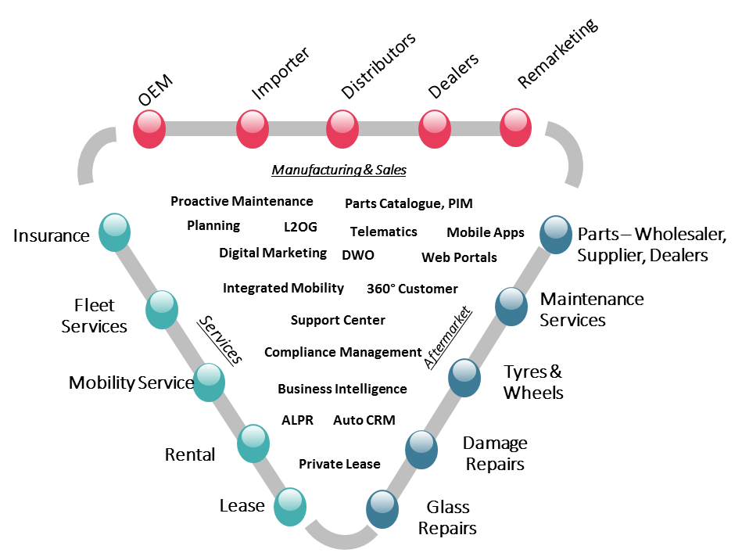
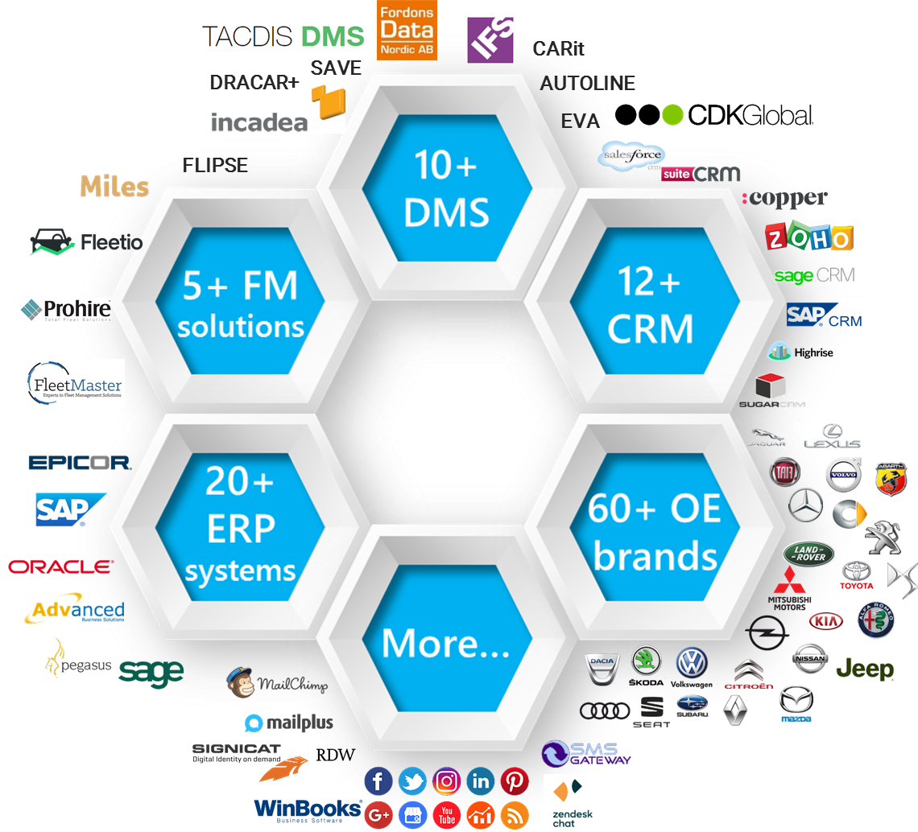






Solutions Brilliance
Technology Excellence
System Integrator
Built 200+ solutions for 50+ Customers
300+ Automotive Engineers deployed to develop modern technology software's for Digital Dealers
Integrating Dealership legacy | ERP | DMS systems to modern day platforms
Supporting Modern Technologies
Big Data
IoT
Supporting Automotive Customers Successfully
AI
ML
Blockchain
100+ Technologies

Slide 14
Sales Landscape – For Dealer Of Tomorrow
ACHIEVEMENTS
FRONT
OFFICE
Digital Customer Connect
Online Sales/ Reserve Portal
Loyalty Program
Pricing Calculator
Customer 360° Portal
Better Sales Number
Higher Lead Generated
Increase Sales
Test Drive Booking & Planner
Dealership App
Virtual Walkin
Lead generation Tool
Car Configurator
Dynamic Pricing Engine
Unified Payment
Dealer CRM
Increase Customer Touch points
Enhance Customer Relation
Shorter Sales Cycle
MID OFFICE
Unified Customer Experience
Self Service Kiosks
Call Center System
Order Tracker
Pic / Clip optimizer
BACK OFFICE
Vehicle
Mgmt.
Sales Assistant App
Logistics Mgmt.
Improve process / workforce efficiency
Higher Production
Reduce Operational Cost
Digital Process Enablement
Quote/Contract Mgmt.
Sales Notification
Analytics Engine
Data Driven Decisions
Customer Behavior Analytics
Sales Dashboard & Analytics
Data Exchange Platform
DMS
GMS
ERP

Slide 15
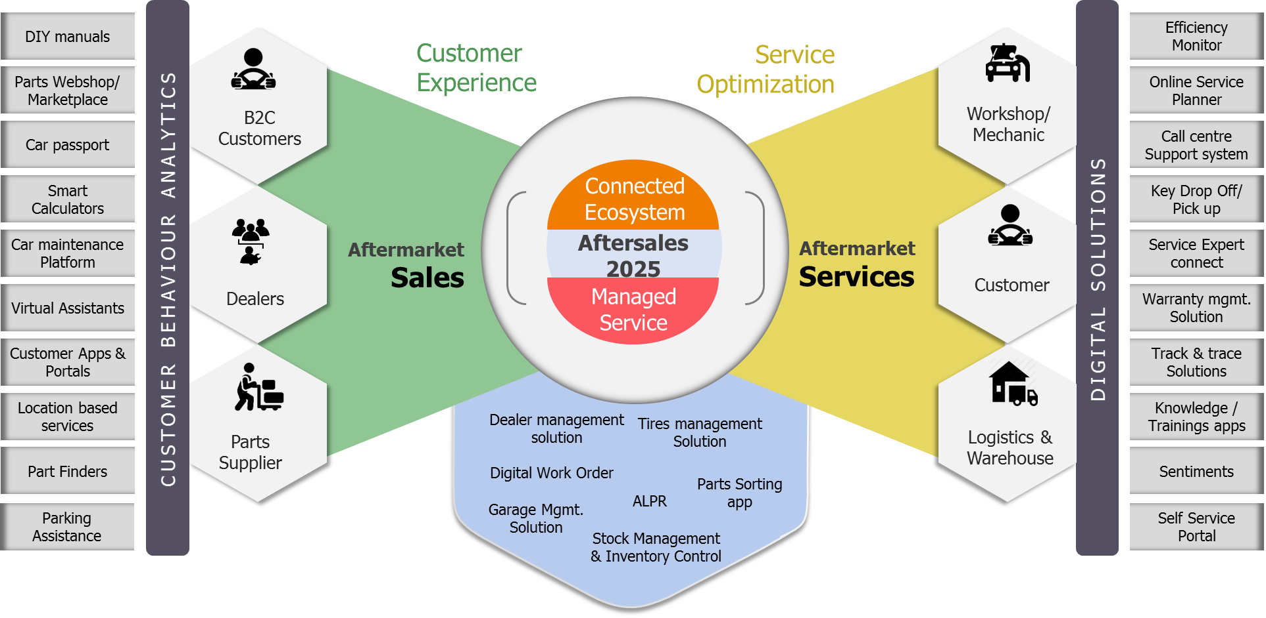
Aftersales Landscape
SEGMENTS
Tires & Wheels | Parts & Accessories | Breakdown | Damage Repair | Maintenance Services

Slide 16




Functional Overview
Portals
(Pre Lease / Rental process)
Operational Lease | Private Lease | Mobility
APPs
(Pre Lease/Rental Process)
Operational Lease | Private Lease | Mobility products
My Lease Portal
(During Lease process)
Private Lease | Captive Lease | Fleet Management
APPs
(During Lease process)
Private Lease | Captive Lease | Fleet Management
Front-Office
Loyalty based apps/portal
Telematics Application
Remarketing Portal
(After Lease)
Database
CRM
Digital Marketing platform
Dealer Quotation / Partnership Platform
SMR / ROB – Car & Bikes
Mid-Office
Data warehouse, BI & Analytics Tool
Dynamic Pricing Engine
Vehicle management
Customer management
Driver management
Track & trace
Offers
Integrations
Subsidiary/ partner management
Reporting
Back-Office
Planning
Work order management
Invoicing
Cost management

Slide 17




Our Understanding
RUN SERVICES
CHANGE SERVICES
L1, L2 AND L3 SUPPORT ACTIVITIES
PROJECT ENHANCEMENT
TECHNICAL EVOLUTION
FUNCTIONAL EVOLUTION
REQUEST MANAGEMENT
INCIDENT MANAGEMENT
PROJECT DEVELOPMENT
CORRECTIVE MAINTENANCE
RA FRAMING, DESIGN
IMPLEMENTATION
TESTING
DEPLOYMENT
ADAPTIVE MAINTENANCE ETC.
TRANSVERSAL SERVICES
QUALITY
GOVERNANCE
ENVIRONMENT MANAGEMENT
SECURITY SERVICES
SLA & KPI COMPLIANCE
RISK MANAGEMENT
KNOWLEDGE & TRANSITION MANAGEMENT
CONTINUOUS IMPROVEMENT SERVICES

Slide 18
STC- WAY OF WORKING

Slide 19
STC
Solution is given directly if the pain areas of the client is known
Wireframes
NFP
POC
MVP
Developed product
Strategic vision exercise
Requirement analysis
Clients
STEP 1
STEP 3
STEP 5
Workshops
Deliverables
Pitch Presentation
Sales team
STC team
Technical team
STEP 6
STEP 2
STEP 4
Approach document
Scope of work
Implementation Deployment
Proposal for the workshop
Solution overview
Functional overview
Final Delivery of solution to the client
Role of STC
STC process document
Notes:
This template was inserted from Power-user, the productivity add-in for PowerPoint and Excel.
Get thousands of templates, icons, maps, diagrams and charts with Power-user. Visit www.powerusersoftwares.com!

Slide 20

Digital Transformation PPT
Case Studies
Feature list
Workshop PPT
Wireframe, NFP
STC
DELIVERABLES
RFP
Proposals
Event Presentation
RFI
Steer Co
Meeting
PPT
White Paper
Strategic
Co-operation Agreement
Pitch Presentation
RFQ
Master Service Agreement

Slide 21
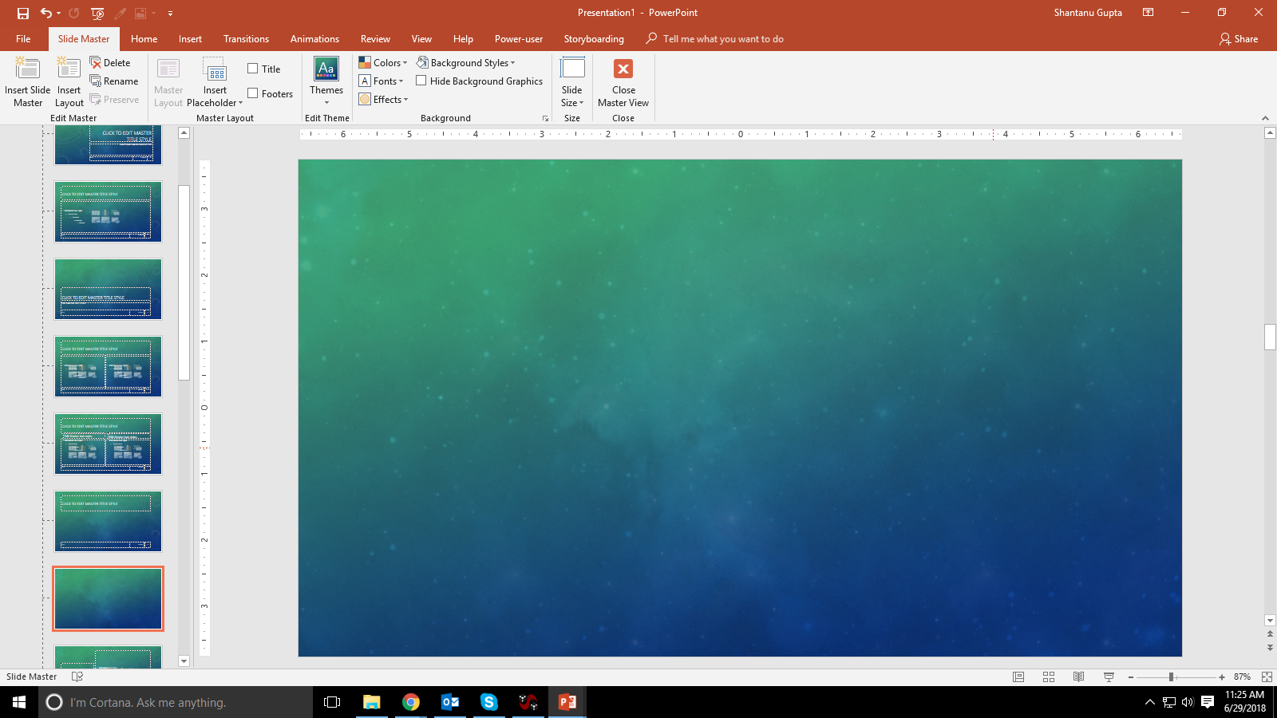

ACTIVITIES
Business Eco-System
SWOT Analysis | Fit-Gap Analysis
Market Dynamics
Observations & Trends
Competitor Analysis
Digital Transformation
Vision & Positioning
Brainstorm
Concepts | Value Drivers | Expectation Matrix
Holistic IT Vision
IT applications Landscape
Technology
Stakeholder’s Interaction
Technology Integrations
External Systems | Applications
Solution Strategy
MOSCOW | NFP | POC
Business Strategy
4P Transformation strategy
Technology Strategy
Tech Solutions | Applications | Frameworks
Roadmap
Concepts →solutions →projects →processes
Implementation
High-level plan | Budget | Team organization | Involvement
TOOLS & TECHNIQUES
X-Mind
Azure
MS Office
Pictograph
Marvel
Google

Slide 22
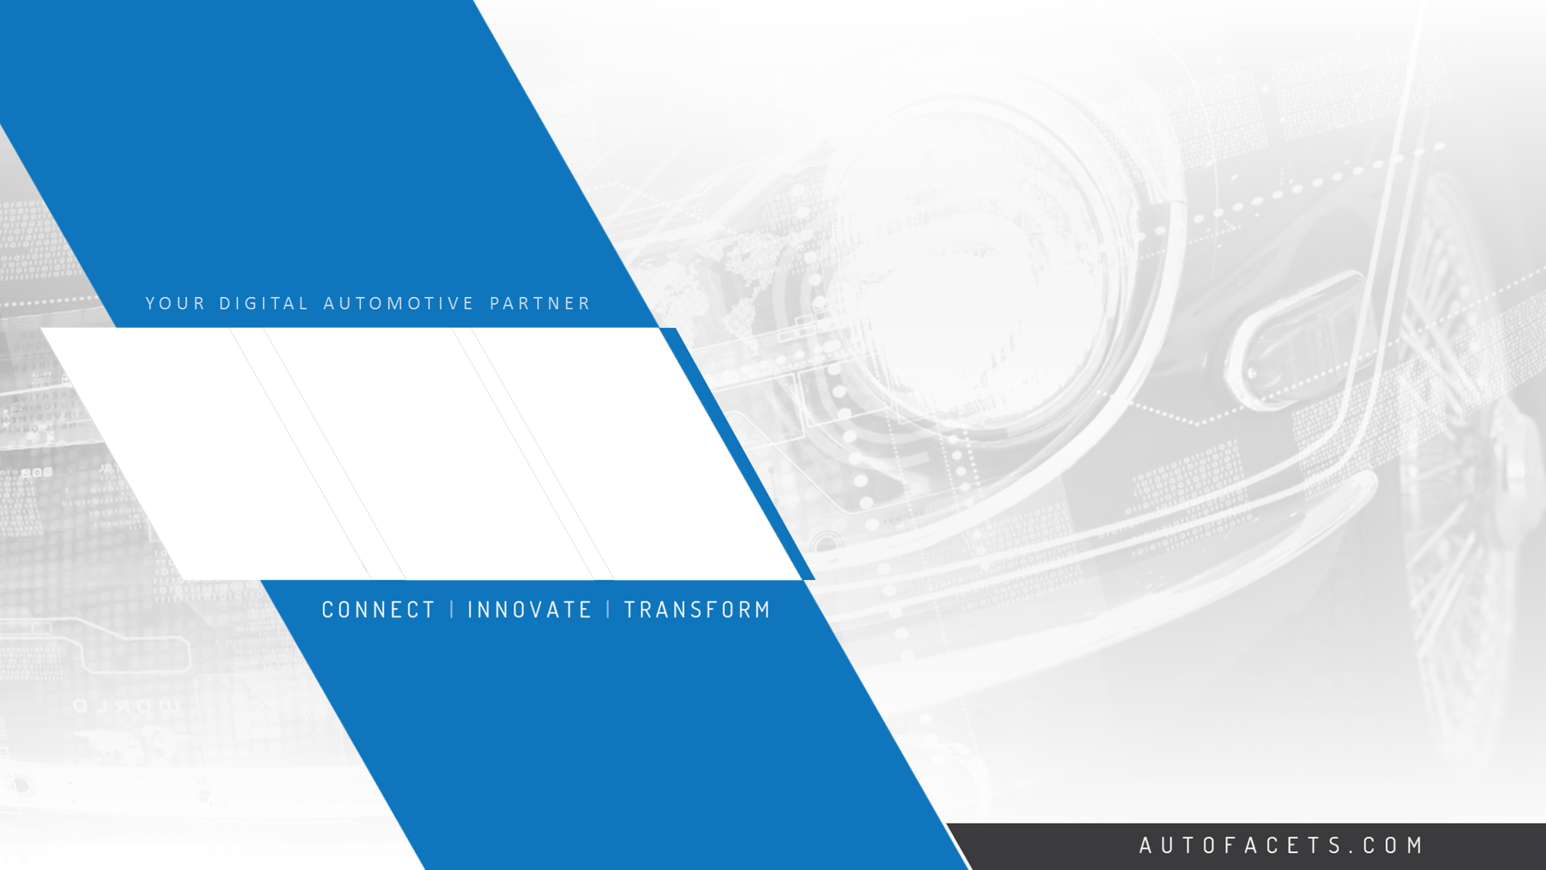

THANK YOU
Contact us
Head office
NINtec B.V. | Gateway Group
Maria Montessorilaan 5, 2719 DB
Zoetermeer, The Netherlands
Phone
+31 79 320 0980
E-mail
info@autofacets.com

Slide 23





















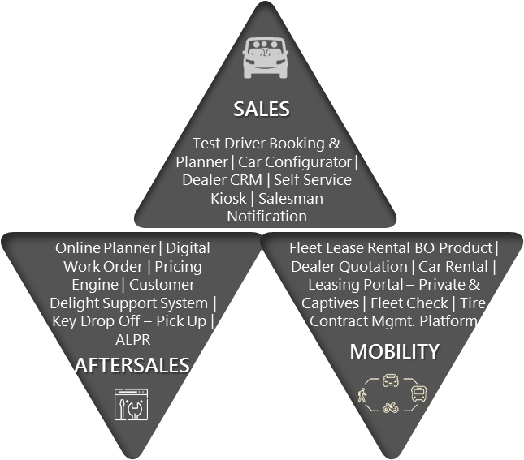



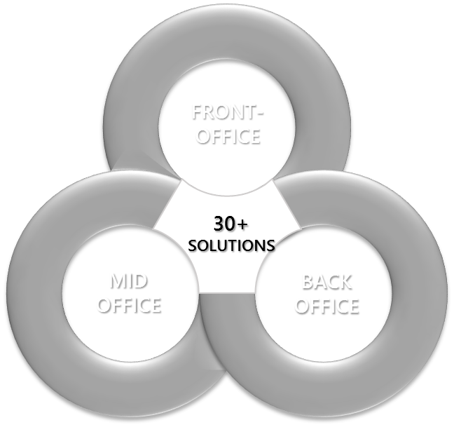
































IMPORTER |DEALERSHIP EXPERIENCE
LEASE | RENTAL | MOBILITY EXPERIENCE
Working with 20+ DEALER | IMPORTER GROUPS
Working with LEADING LEASE & FLEET CUSTOMERS
EVA
SAVE
Fleet Lease Rental | Customer App & Portal | Car Rental | Leasing Portal – Private & Captives | Fleet Check | Mgmt. Platform | car Sharing | Lead To Order| PLOS
Belgium
CAR IT
X-entry
CRM | Data Warehousing & Analytics| Remarketing Portals | Dynamic Pricing Engine | Check-In Check-Out Portal | Customer Service Platform| Call Center Support Solution
Fleet Management Portal | Vehicle Inventory Manager | Planner Solutions| Repair Solutions | Full Service Leasing Platform | Tracking & Monitoring Solutions
DRACAR+
Superservice
Paperless Dealership
100% Digital Dealership
Maximum Automated Dealerships
100 %
Online & Digital
Leasing Process
Support Partner Ecosystem
Shortest lease Conversion Cycle

Slide 24
Aftersales
Augment Aftersales Services and Surge Productivity
Damage Intake (Augmented Reality)
Parts Sorting (AR Based - Glass)
Annual Maintenance Program (Loyalty)
Dealer Planner (AI + ML Based)
Performance Dashboard
Automatic LP Recognition - Alerts
Digital Service Order (Tablet)
Recall Management (Connected Campaign)
Automized Schedule
DMS Connectors
Reception Mang (Welcome, Waiting time ++)
Booking Tracker (Real time order mgmt.)
Dynamic Pricing (Menu + Service)
Rental Car Mang (Individual + 3rd party Connector)
Campaign Manager - Aftersales
Financial Package Connectors
Revenue Management
Central - Smart Planner
Importer Mang. Connector
Self Servicing Kiosks
Centralized Dealer Management
Importer Packages Management
Social Engagement
CRM Connectors
MyCar - Connected APP (Customer)
Technical Manual Mang. (Tablet Solution - DSO)
Customer 360'
MyCar - Customer Portal / APP
Tire Management
Customer Count - IOT
OLB - White Label
Used Car - Intake & Valuation
Customer Delight Service Solution
Online Booking - Widget
Warranty Management
Customer Relationship Management (CRM)
Optimized Labour Package
Webshop (Parts, Accessories, Merchandize)

Slide 25
Sales
Painless car buying experience for end customers
Performance and Prediction Dashboard
Campaign Manager
Reception Screen
Car Configurator
Sales and Lead Management
Car Tracker
Sales Kiosk
Customer Portal + APP
Sales Notification
Dealer Ordering System - Importer Connector
Sales Rep App
Digital Workspace
SLA Management
Dynamic Pricing - New and Used Car
Smart Calculator
Financial Integrator
Social Engagement
IOT - Thermal Device - Counter
Survey Engine
Lease Integrator
Test Drive APP
New Car - Sales Portal
Used Car Management + Portal
Online Dealer Portal
Webshop

